Slide 1


COMPARATIVE ANALYSIS
Challenges and gaps of health
insurance policy in Bangladesh and
how to solve extent conundrum based
on health security system in Japan

Slide 2
Presented By
Mahmuda Akter Asa
ID: 2527047680
Dr. Nashid Sultana
ID: 2527295080
Submission Date
Nawreen Jahan
ID: 2527522080
05 December, 2025
Department
Department of Public Health
North South University

Slide 3



Health System Overview
Definition & Goals
A health system consists of all organizations, institutions, resources, and people whose primary intent is to promote, restore, or maintain health.
Core Goals: Improving population health, responding to expectations, and providing financial protection against illness costs.
The Bangladesh Context
Health care finance is crucial, but unfortunately, Bangladesh spends less than 1% of GDP for health, which is one of the lowest in South Asia.

Slide 4


Context: Rights & Reality
Constitutional Mandate
Global Comparison
Article 15 of the Constitution of Bangladesh states the fundamental principle to ensure the fulfillment of basic necessities.
Japan is globally recognized for its universal health coverage (UHC) model.
Bangladesh still faces gaps in coverage, resources, implementation, and governance.
The state is directed to ensure the provision of basic needs such as food, clothing, shelter, and medical care.
This report compares the existing systems to identify solutions for Bangladesh.
Health insurance plays a fundamental role in ensuring this financial protection and access to quality care.

Slide 5








Scenario of Health Insurance in Bangladesh
Minimal Coverage
Govt. Benefits
Pilot Schemes
Private Sector
Government employee health benefits exist but are reimbursement-based, not true insurance.
Community-Based Health Insurance (CBHI) and schemes like SSK are limited to a few sub-districts.
Mainly covers corporate employees. Struggles with inequitable access and insufficient chronic disease coverage.
Less than 1% of Bangladesh's population is covered by any formal health insurance.

Slide 6
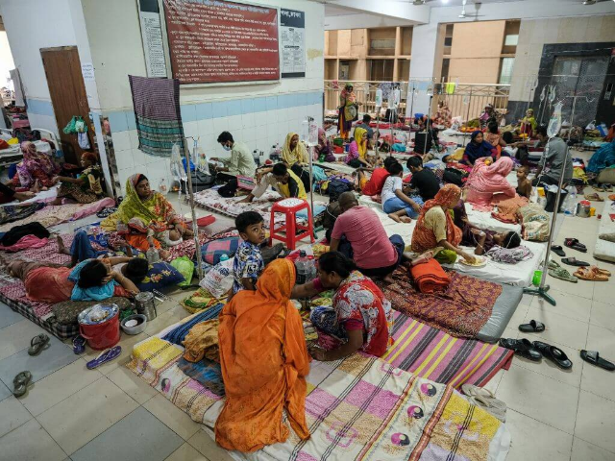
Impact of Lack of Insurance
•
High Out-of-Pocket Expenditure (OOP): Over 67% of total health expenditure is paid directly by households.
•
Catastrophic Health Expenditure: Many families fall below the poverty line due to medical bills.
•
Limited Access: Poor and rural communities avoid treatment due to cost.
•
Pressure on Public Hospitals: Leads to overcrowding and poor service quality.
•
Medical Tourism: Many seek treatment abroad due to dissatisfaction.

Slide 7
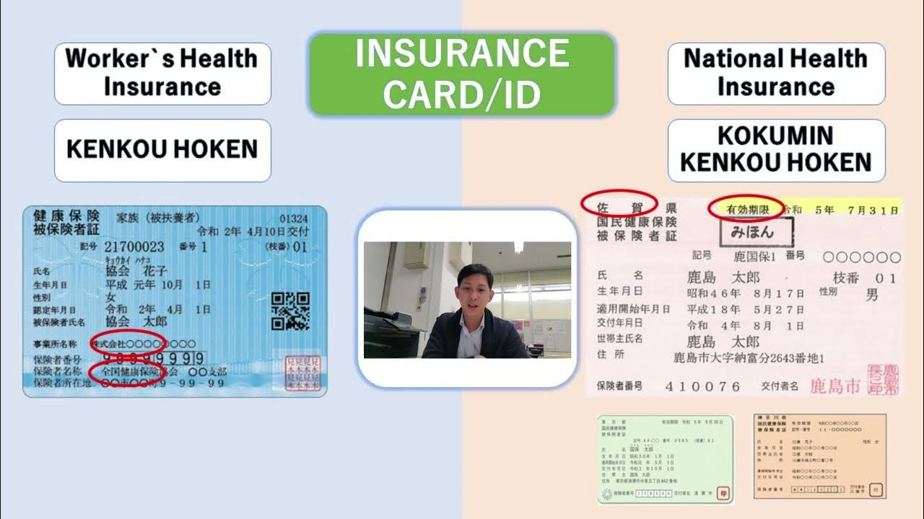
Health Insurance Model in Japan
Universal Coverage
Established in 1961, ensuring all citizens and residents are covered. Funding is a mix of premiums, co-payments (typically 30%), and government subsidies.
Two Main Schemes
•
Employees' Health Insurance (EHI): For salaried workers.
•
National Health Insurance (NHI): For unemployed, farmers, elderly, and students.
The system is highly regulated with standardized fees, promoting cost control, equity, and access.

Slide 8

Comparison: Bangladesh vs. Japan
Feature | Bangladesh | Japan
Coverage | Limited coverage (<1% formal insurance). | Universal coverage for all citizens.
Funding | Heavily reliant on Out-of-Pocket payments. | Multi-source: Premiums, Taxes, Co-payments.
Access & Equity | Unequal; urban areas have better facilities. | High accessibility with well-distributed infrastructure.
Challenges | Low funding, infrastructure deficits, administrative inefficiency. | Demographic pressures (aging society) and cost inflation.

Slide 9

Recommendations for Bangladesh
Introduce National Mandatory Health Insurance similar to Japan.
Establish a National Health Price Authority for standardized fee schedules.
Develop a long-term 10-year UHC Implementation Plan.
Expand the SSK Scheme nationwide targeting low-income families.
Strengthen governance and monitoring oF insurance authorities.
Implement Public-Private Partnerships (PPP) for insurance packages.
Collaborate with Japan for technical support, accreditation, and technology transfer.

Slide 10
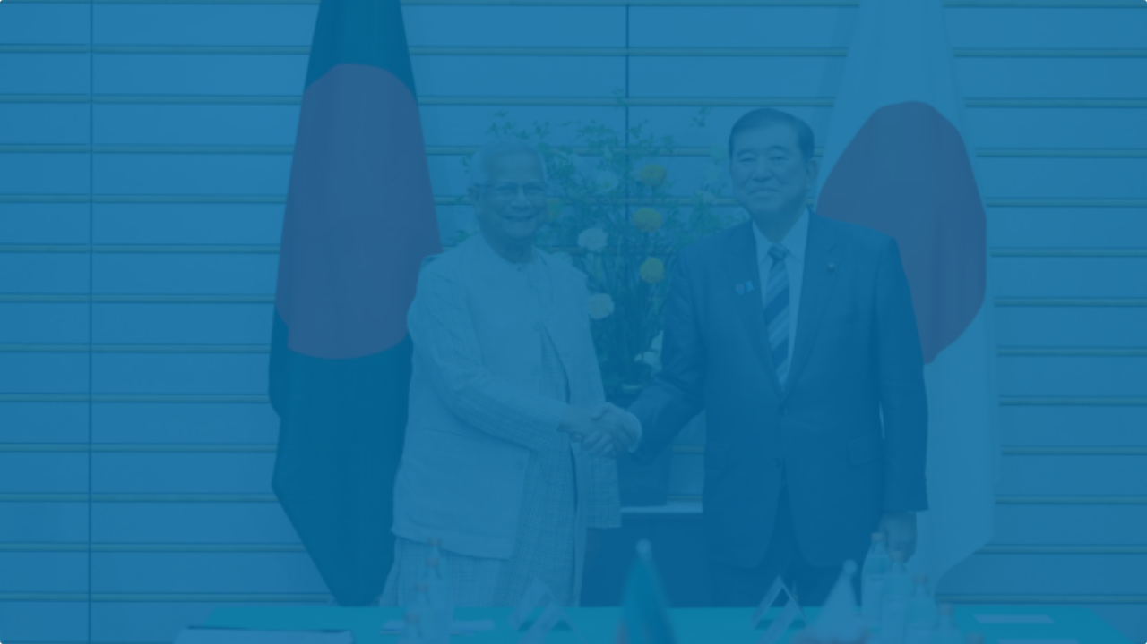
Conclusion
Japan's health policy is a well-structured system offering comprehensive financial protection.
In contrast, Bangladesh is in the early stages. Learning from Japan's experience in universality, Bangladesh needs to increase public investment, expand coverage, and strengthen regulations.

Slide 11
Questions?
Thank you for your attention.

